Slide 1


Cost of living crisis: Corporate fundraising
January 2023
Tom Burstow

Slide 2


Introduction and objectives
A guide to Corporate Fundraising – and connecting to the Cost of Living crisis
Introductions & housekeeping
The 3 aims of today:
  To introduce or remind you of key corporate fundraising points
  To relate corporate fundraising to Cost of Living challenges
  To share and discuss experiences, challenges and top tips
Session approach – Input, Questions & Discussion
Notes:
Session approach
Big corporates examples – but increasingly relevant to smaller orgs to
You can apply to your situation too
Loads of text, points – designed for use afterwards

Slide 3

Defining corporate fundraising
“pursuing a relationship with a company that involves a gift, commitment of support or other monetary transfer to the fundraising party”.

Slide 4

What are we going to cover?
1. Being clear on motivations
2. Defining your assets
3. Doing your research
4. Making an approach
- - - - - - - - - - - - - - -- - - -
5. Negotiating and agreements
6. Managing your relationship
Summary of top tips – 5 mins
Questions – 10 mins
Breakout discussion – 10 mins
Final thoughts – 5 mins
30 mins
“If it wasn't for the fantastic support from Sported, our club would no longer exist.”
June Kelly
Abraham Moss Warriors Football Club
Notes:
Sometimes these don’t go in this order…or some steps don’t happen at all. Lucky!

Slide 5

A SHORT GUIDE
TO CORPORATE FUNDRAISING
AND THE COST OF LIVING CRISIS

Slide 6

1. BEING CLEAR ON MOTIVATIONS CORPORATE
    Why do companies get involved with charities? What do they want/need?
OWNER / SHAREHOLDER
STAFF
CUSTOMERS
Reaching new audiences
Positive profile (brand building)
CSR policy (need to ‘give back’)
Staff engagement
Positive feeling about employer
Chance to get involved in giving back
Staff engagement
Demonstration of company values
Increased recognition of company and its products
Positive feeling towards company
Local connections between people & business
Notes:
Trends
- Local community

Slide 7
1. BEING CLEAR ON MOTIVATIONS YOUR ORGANISATION
    Consider whether corporate fundraising is really right for us?
Pros
Multiple areas of benefit available
May lead to growth in other areas
Potential flexibility along the way
More relationship-based – can be fun!
Long term support & growth possible
Cons
Can be time consuming to develop & manage
New requests can appear along the way?
Risk of mission drift chasing funds?
Harder to say no?

Slide 8
1. COST OF LIVING CRISIS – IS IT A GOOD TIME OR BAD TIME FOR CORPORATE FUNDRAISING?
Positive
  Many companies want or need to respond to crisis
  Community, young people are relevant, powerful issues to tackle
  Small amounts can make a big difference
  Greater recognition and support for core costs
  Non-financial offers can really help too.
Negative
  Many companies are struggling – so have reduced or removed charity activities
  Many charities have lost income so competition for partnerships increased
  Support increasingly non-financial
  The Sported experience so far…..

Slide 9
POSSIBLE ACTION: CONSIDER AGAINST OTHER FUNDRAISING SOURCES?
    How does corporate compare to other income sources? Does it work for your needs, capacity, plans?
Income Source | Financial value | Time & Resource required | Flexibility of support | Additional potential
Corporate
Trusts & Foundations
Statutory bodies (e.g Sports Councils)
Community Fundraising

Slide 10
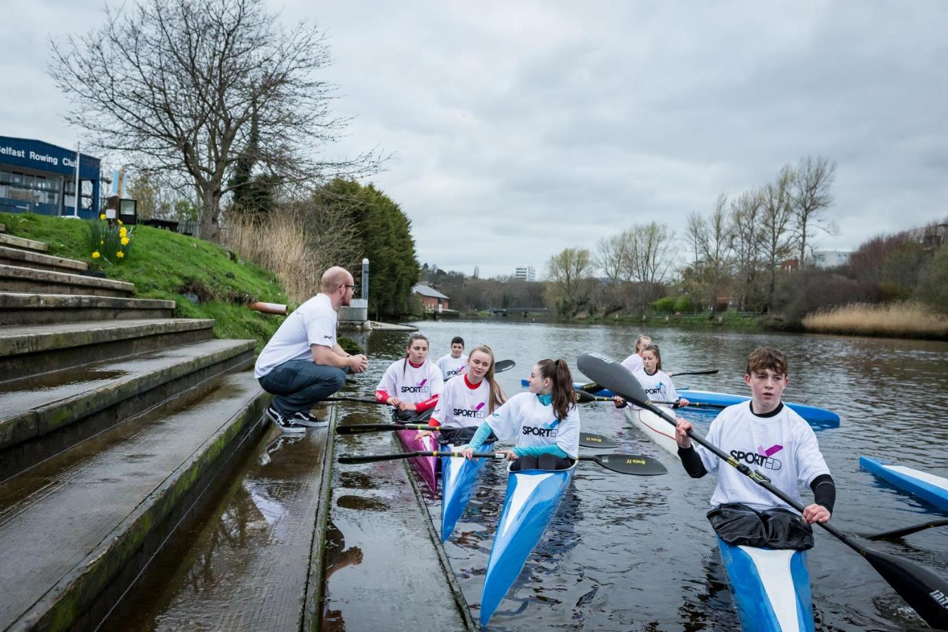
2. Define
your assets

Slide 11
2. DEFINE
YOUR ASSETS / IMPACT
    Think about what you can offer that might be of interest to corporates?
Reach
  Participants - who, how many, where,
  Others – supporters, community members
Activities – sport, theme, delivery (time, location, method)
Needs – manpower, skills, equipment, services, venues
Results - ‘content’ through stories, images, film
Be really clear and quantifiable on what you have and the value of that to you/others

Slide 12
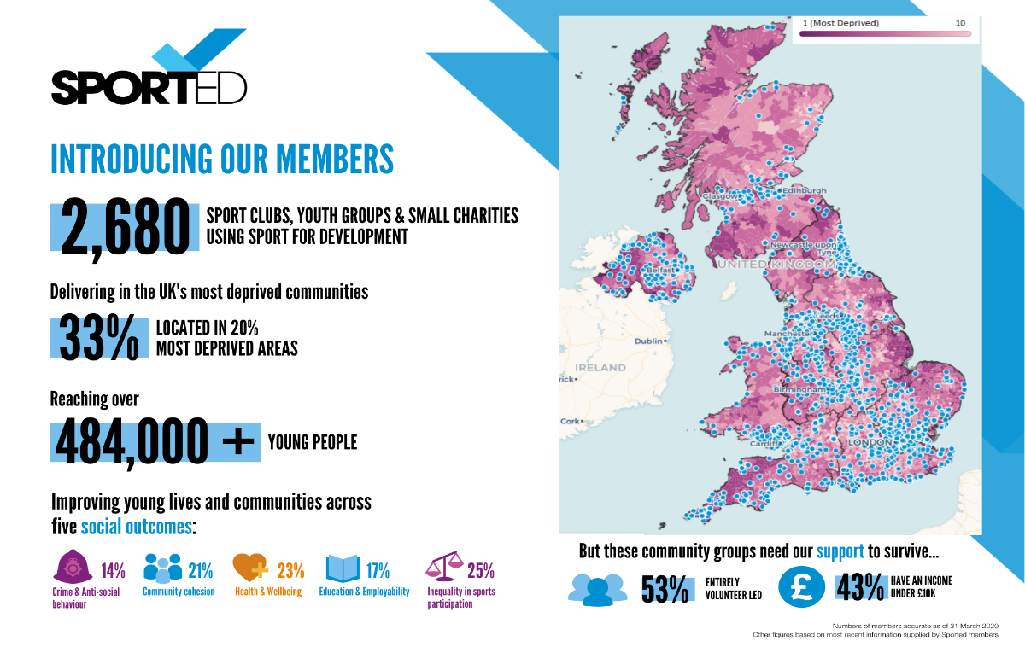
Our London network
Notes:
Tom

Slide 13

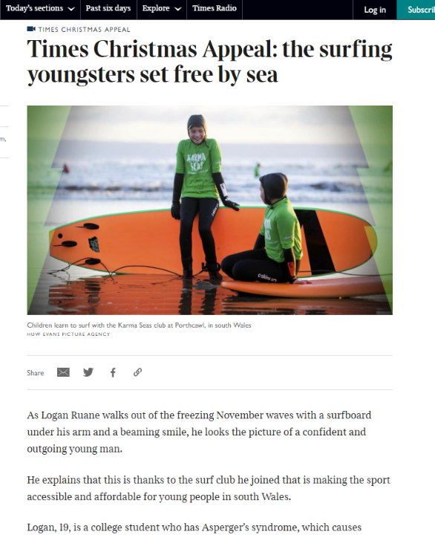
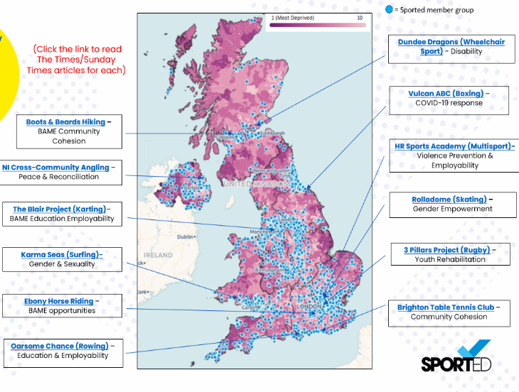
EXAMPLE
SPORTED GROUPS

Slide 14
2. HIGHLIGHTING THE NEED…AND URGENCY
    GENERIC NATIONAL STATISTICS
83% of young people’s mental health worse since COVID
70% cut in youth provision across the UK in last 10 years
43% of young people describe group leader as a key trusted person for them
30% of young people in the UK live in poverty
67% of Sported members suggest half their young people may stop attending due to finance
93% of group leaders are worried about their organisation; 94% for young people’s wellbeing
50% have seen a significant drop in income as a result of the cost of living crisis
    YOUR OWN EVIDENCE
    ISSUE PLUS URGENCY = NEED FOR RESPONSE NOW

Slide 15
2. HIGHLIGHTING THE NEED…THROUGH STORYTELLING
    BROUGHT TO LIFE VIA STORIES ….AND POWERFUL QUOTES
Gymnastics group - "Thank you so much. You are dead right about the cost of living, this weather has not helped us. As gymnasts have to be in a leotard and barefoot mostly we have had the heating on full this last while!! This funding would be a great help towards that, Industrial units are very hard to heat and require the heating on constantly.“
Judo group - Our utility bills have increased by an alarming amount. (more than double in the past year). We can't stay open if this continues. This funding will be a massive relief on stress of everyone if we know we can keep the lights on and not freeze.
Karate group - using all the £ to subsidise membership for YP who otherwise couldn't attend
https://youtu.be/TYNPx2jngvs
RAPAID – Sky Sports coverage
Story of mother who can now only afford to send 1 child out of 3 to football – due to cost of living crisis

Slide 16
3. Do your
research

Slide 17
Do your research and make connections
    Develop strong understanding of areas of synergy. What are their challenges or focus areas? How could we help?
WHERE TO FIND OUT
Contact at company?
Company website
CSR/charity report
Local comms
Social media focus
Brand/corporate values – ‘walking the talk’
Staff engagement – giving back meaningfully / locally
Connection to new audiences – new offices, new products
Good news stories – to counter the bad??
Ongoing consideration is how genuine is interest / support? Are they ticking a box?

Slide 18
Do your research and make connections
    Who do we know or can get to know that could help?
Board/Committee member connections
Club Member relatives or contacts
Social Media contacts
LinkedIn connections
Previous event attendees
Local paper/websites
Company report authors
Warmest Connections

Slide 19

Be clear on
what you want

Slide 20
Be clear on what you want
    What is it that we want from corporate support?
    (not a stupid question!)
Project funding
Staff fundraising
Charity of the Year
Supplier fundraising
Licensing and/or CRM
Sponsorship (event/activity)
Payroll giving
Donations/matched giving
Staff secondments
Employee involvement and volunteering
Gifts in kind
Royalties
Affinity relationships
Product endorsement
Events
Recycling

Slide 21
Be clear on what you want
    Is there a good mix of ££ plus other support? Where can they best help us?
Connections
Profile
Financial support
Increased profile (telling your story)
Volunteer manpower and skills
Facilities (in kind support)
New supporters / audiences
Staff
Value of
Whole
Deal
Funds

Slide 22

4. Making
an approach

Slide 23
Making an approach
    Consider who and how – before what
Think about the best of what you can show as well as tell
Social Media links
Clips of activities
Short interviews
Photos, quotes, stories
Whatever makes your story come alive
Approach via contact if possible
Is there an informal opportunity to meet/share?
If not, consider best person to speak or send to
Will you call, email, apply – consider most powerful option?
Timing….and chasing

Slide 24

Making an approach
    What should I share of our work?
Short, punchy, relevant to their needs/interests
Make emotive and personal to them if possible
Make clear your results:
  Hear from a ‘beneficiary’
  Invite to see your work
Consider when to ask/mention funds? Up front? Talk about other, non-financial needs as well.
Make it easy for them
THE SO WHAT FACTOR?

Slide 25
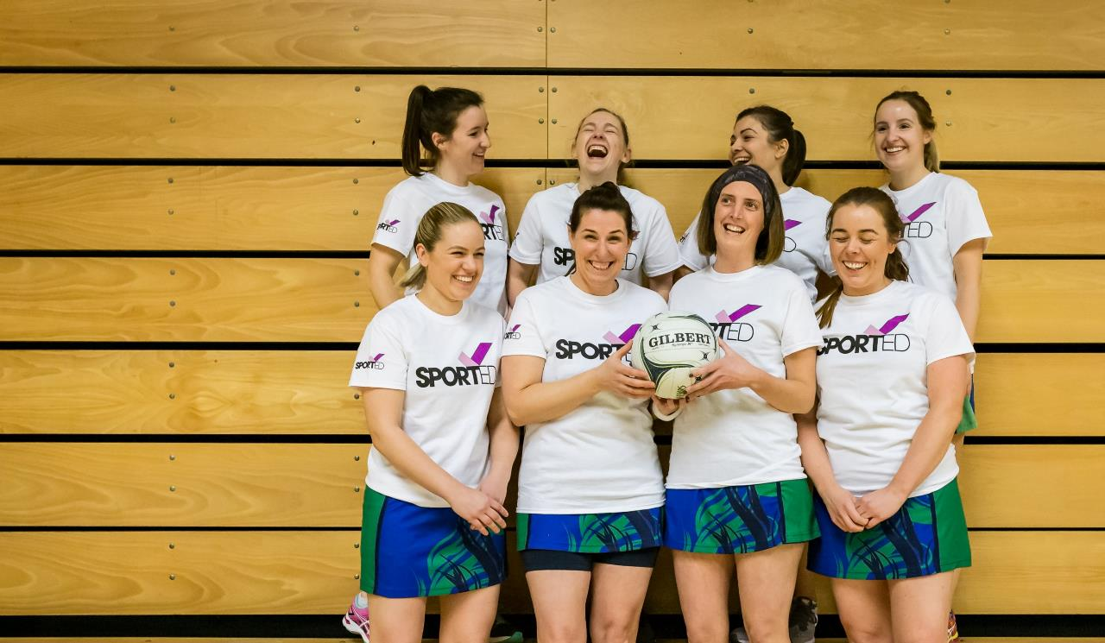
5. Negotiating
and agreements

Slide 26
Negotiating and agreements
    Do we really need a contract?
Not necessarily, but some form of written confirmation important
Not just legal value; provides clarity on what’s agreed;
But be proportionate – consider options
If contracting, get a second opinion on terms
Consider unlikely scenarios – what if?
Worth spending time to get it right – it can uncover differences up front
DIFFERENT TYPES OF AGREEMENT
Email confirmation
Basic Letter of Agreement
Memorandum of Understanding
Formal Contract

Slide 27
6. Managing
the relationship

Slide 28
Managing the relationship
    Getting the deal is half the challenge….now make it work!
Consider renewal/expansion from the start – working towards long term support
Build relationships – around and beyond key contact – ‘layers’
Create trust and openness
Communicate regularly – make them feel a part of the family
  Milestones as they happen
  Events – yours and others
  New partnerships/funding
  Other significant changes at your organisation
  Relevant news story from others (showing value of your work)
Follow your plan; but alert quickly if things not working out
Think about other value you can bring – introductions, support at events, insight?
Partnership not project!!

Slide 29

Case study: what can happen
    Long term supporter
    Staff changes at both ends
    Little engagement
    Organisational understanding reduced
    Original direction & enthusiasm lost
    Misplaced assumption that all was fine
Notes:
Gonna tell you a story…

Slide 30
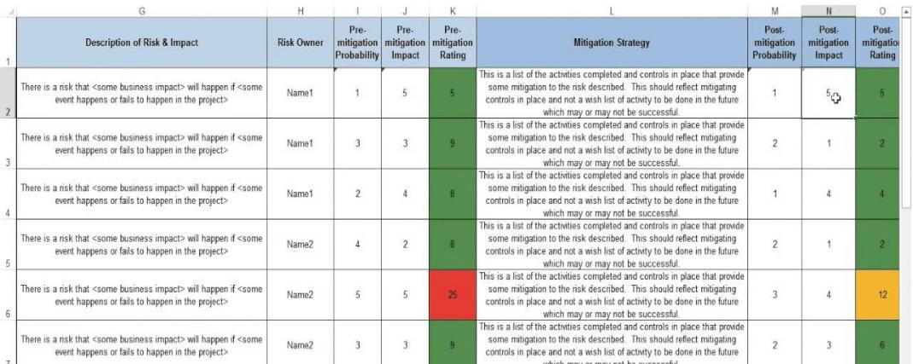
Managing the relationship
    Risk register – considering risks and how to mitigate them
    https://knowhow.ncvo.org.uk/tools-resources/risk-management/template-risk-register
Not

Slide 31
Managing the relationship
    Keeping it going…..through renewal or expansion
Think about it from Day 1 - work towards long term support
But still leave plenty of time to plan end of current relationship
Meet to discuss with partner - consider what’s worked well and not, areas to grow/continue
Be aware of their business, changes in focus/interest – & your response
Use all levers to gather support (your network)
Don’t assume anything!

Slide 32

In Summary….

Slide 33
Summary of top tips
Demonstrate urgency – cost of living is NOW. (know the challenge)
Be really clear about what you want and can offer (know your ask)
Invest time up front to save time later (know your stuff)
Build and maintain relationships (know your partner)
Consider the corporate perspective (know their business!)
Don’t agree to everything! (know your limits)

Slide 34
some useful websites
Institute of Fundraising – Corporate Fundraising
  https://www.institute-of-fundraising.org.uk/guidance/corporate-fundraising-trusts-and-foundations/corporate-fundraising/
Third Sector – Corporate Fundraisers toolkit
  https://www.thirdsector.co.uk/corporate-fundraising
NCVO – Corporate Fundraising Guide
  https://knowhow.ncvo.org.uk/funding/fundraising/corporate-fundraising#
NCVO – Approaching Local Businesses for Donations
  https://knowhow.ncvo.org.uk/how-to/how-to-approach-local-businesses-for-donations
EventBrite – How to secure event sponsorship
  https://www.eventbrite.co.uk/blog/guide-to-event-sponsorship-ds00/
Guardian – How to secure a Charity of the Year partnership
  https://www.theguardian.com/voluntary-sector-network/2013/jan/29/become-companys-favourite-charity

Slide 35
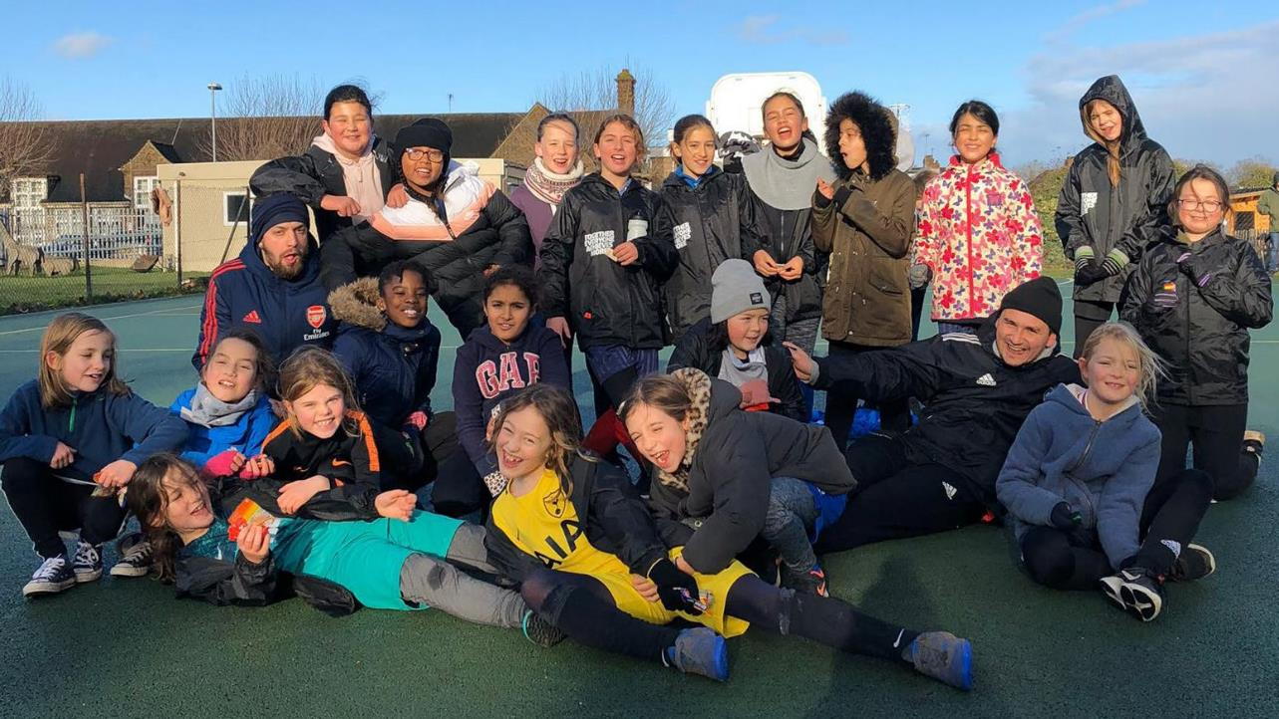
Any questions?

