Slide 1
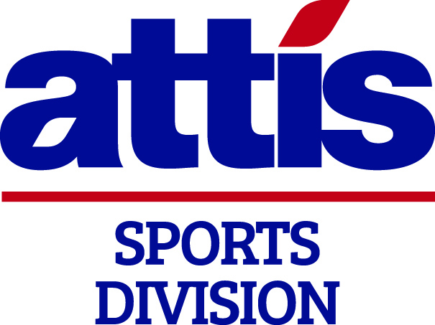

Insurance in Sport
Alyn Spratt – Director
07786 768431
alyn.spratt@attissports.com
www.attissports.com

Slide 2
Agenda
Introduction to Attis Sports
Overview of current market
Challenges you and other organisations face
Strategies for you ahead of renewal
Q & A

Slide 3

Attis Insurance Brokers
Independent Insurance Brokerage est. 2021
  Founded by Joe Henderson MBE
  We have decades of specialist expertise within our sectors
  ‘Who Cares Wins’
  100 Staff and £60m GWP
  Insurance Broking, Claims Management, Risk Management Consultancy, Medical, Wealth and Employee Benefits

Slide 4
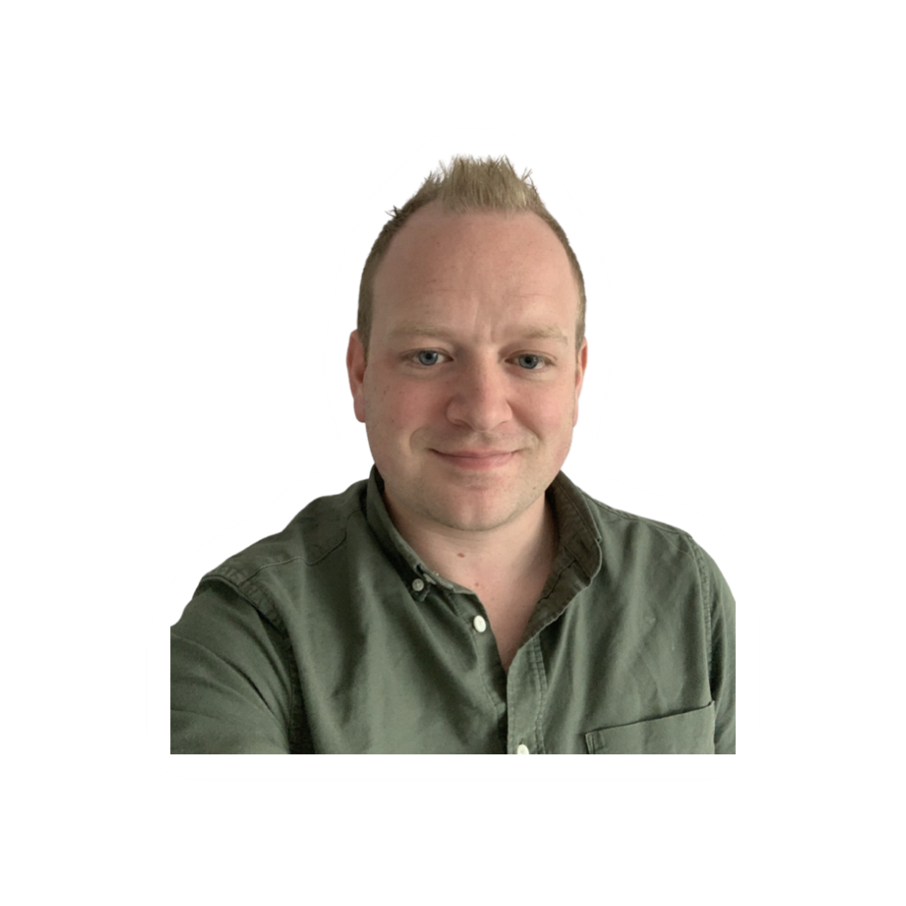
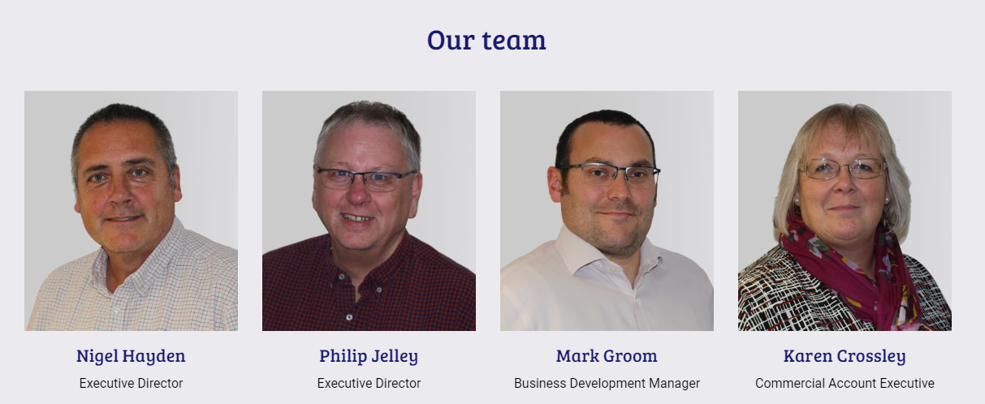
Introduction to Attis Sports Division
  Joined Attis Sports in July 2022
  20 years industry experience - specialised in Sport and Leisure for the last 15 years
  Worked for two of the largest brokers globally
  Clients have ranged from Amateur to Professional Clubs, National Governing Bodies to International Event Organisers and Leisure Operators through to Commercial Business within the Sport ‘eco-system’
  The sport team have combined 60+ years in the Sport Insurance sector

Slide 5
Overview of current market
  Generally, everybody is facing a challenging insurance market
  Sport & Leisure sector across the UK are all facing challenges with organisations in NI particularly effected
  Rating increases anywhere from 10% to 25% for claims free risks. Considerably higher for those with claims
  Some reasons include:
    Current market volatility
    Still some implications from Brexit
      Impacting for All Ireland Bodies
    Reducing Capacity and Narrowing Risk Appetite

Slide 6
Reducing Capacity and Narrowing Appetite
  Number of insurers have withdrawn from the Sport & Leisure sectors. Sports facing increased challenges include:
        Contact Sport – mainly Football & Rugby
        Motorsport
        Golf
  Why?
    Many factors at play, these include but are not limited to:
      Concussion / CTE Class action cases underway in Rugby with a group of 40 retired Footballers preparing to take similar action.
      Narrowing appetite of underwriters who are keen to ‘cleanse’ their book of poor performing risks or sports that carry a high frequency or severity of claims
      Discount / Ogden Rate – undoubtedly causing biggest impact to insurers position/view of Northern Ireland
    Cont…

Slide 7
Reducing Capacity and Narrowing Appetite
  What is the Ogden/Discount Rate?
    Also known as personal injury rate
    Method of award calculations for major personal injury claims.
    Higher Discount Rate = Lower Claims Settlement
    Insurers factor this rate into their pricing models
    22nd March 2022 Justice Minister, Naomi Long introduced the lowest discount rate in the UK for Northern Ireland at -1.5%
    Let me give you an example of how this effects claims costs for insurers….
    Cont…

Slide 8
Effect of varying discount rates on an award for annual care costs of £100,000 for the rest of claimants life.
Discount Rate | Total Award
 | 40 year old male with normal life expectancy | 10 year old female with normal life expectancy
2.5% (Old UK Wide Rate) | £2,652,000 | £3,475,000
-0.25% (New Rate England/Wales) | £4,876,000 | £9,128,000
-0.75% (New Rate for Scotland) | £5,566,000 | £11,470,000
-1.5% (New Rate for NI) | £6,632,000 | £15,925,000

Slide 9
Other challenges we are seeing…
  Conditions being applied to Public Liability cover to exclude or restrict cover in respect of Abuse and Concussion/CTE claims
  Increased excesses being applied especially in higher risk sectors and leisure operators
  Insurers struggling with Total Sum Insured limits – relevant for clubs or organisations that may have large Property and Business Interruption sums insured.
  Clients have to source ‘Excess Layer’ cover to top up Public Liability limits becoming more common. Again leading to more premium.

Slide 10
Strategies
  Early Engagement
    4 to 6 weeks ahead of renewal – don’t wait for your broker to contact you!
    Some General Insurance Brokers may not be aware of the challenging market conditions in advance of handling your renewal.
  Be armed with Risk Information
    Request your 5 year Confirmed Claims Experience
    Have sample Risk Assessments, especially for any high-risk activities.
    Be informed in respect of your Child Protection Policies, Security or Alarm details and any other key information
    Consider Adequacy of your sums insured and policy limits
  If you choose to seek alternatives…..don’t engage too many Brokers
    Counter productive to have more than two (or max three) involved
    Speak to a Specialist Broker, for example…………….Attis Sports
    Being armed with your risk information will produce best results

Slide 11
Adequacy of Sums Insured and Limits
  Considerations
  Buildings Valuation
    When did you last seek Professional advice regarding your buildings sum insured?
    Professional Buildings Valuations are recommended at least once every 5 years
    Services available for as little as £105 + VAT to answer this question
  Public Liability – Limit of Indemnity
    Considering the impact of Odgen/Discount rate – is your current Limit adequate?

Slide 12
Questions?
Thank You
Alyn Spratt – Director
07786 768431
alyn.spratt@attissports.com
www.attissports.com

