Slide 1


Finances
The basics of financial planning
Paul Steele

Slide 2

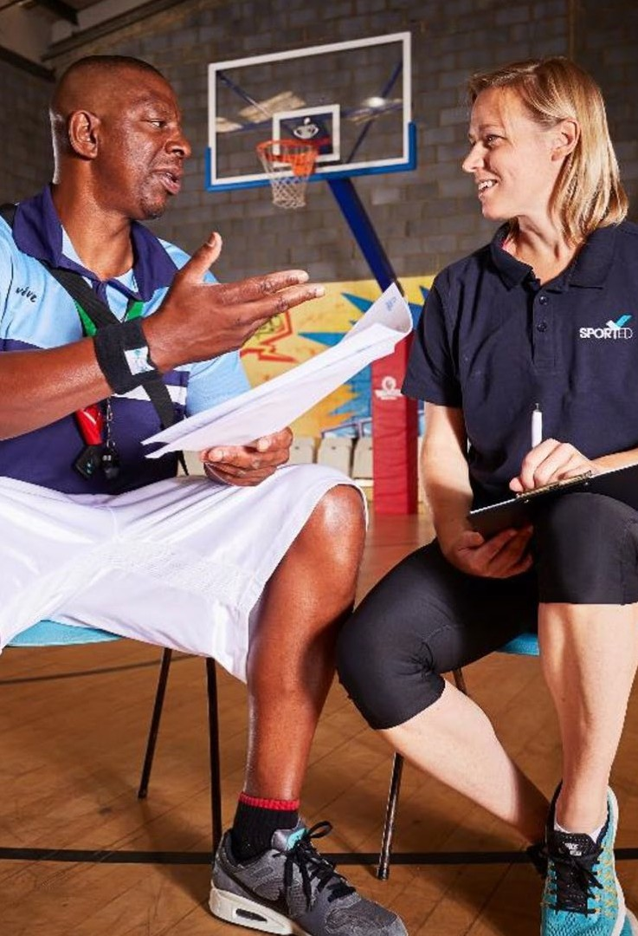
Objectives
To gain a basic understanding financial forecasting and applying this within your organisation
Identify support and resources to support you

Slide 3

Why?
Kids Company – as soon as financial issues hit the press funders suddenly get very nervous
Without the knowing what the costs are likely to be then there is a risk of becoming insolvent- Cashflow crisis
Funders expect good financial planning.
Confidence from stakeholders including Trustees/ committee/ directors- opportunity for recruiting volunteers
Making effective purchasing decisions – hiring staff
Understanding Fixed costs and Variable – essential where a building is involved
To predict any foreseeable down turns such as seasonal fluctuations where additional resources are required
Helps meet Regulatory requirements

Slide 4
Budgeting vs Forecasting
A budget is what you would expect to happen- this is what we have to spend.
E.g. our budget for this month is £1000 and we expect to spend £750
A forecast is a prediction into the future that may change – British weather!!!
Generally done over a period of time such as 12 months and the performance against the cashflow is monitored and updated

Slide 5
Forecasting
The key principle of planning is Forecasting Income
and costs:
It’s always easier to use historic information;
Predict what income will come in month by month – remember to consider seasonality fluctuations – i.e. will there be less people attending in August, December lulls.
Predict what costs will be on a monthly basis- again consider seasonality fluctuations and of course ENERGY COST INCREASES!!
If forecasting beyond a year include inflation on all costs.
On a month-by-month basis you will have a closing and opening balance.
Cash is king!!!
“The best predictor of future behavior is past behaviour”, Albert Ellis

Slide 6
A cashflow forecast -example
Run Away Forecast | Pre-Start Up | January | February | March | April | May | June | July | August | September | October | November | December | TOTAL
Donation |  | 186 | 186 | 186 | 186 | 186 | 186 | 186 | 186 | 186 | 186 | 186 | 194 | 2240
Grants |  |  |  |  | 30000 |  |  |  |  |  |  |  |  | 30000
Sessional fees |  | 2391 | 2391 | 2391 | 2391 | 2391 | 2391 | 2391 | 2391 | 2391 | 2391 | 2391 | 2400 | 28701
Fundraising events |  |  |  |  |  |  |  |  | 1030 |  |  |  |  | 1030
Sponsorship |  |  | 604 |  |  |  |  |  |  |  |  |  |  | 604
Power to Change |  |  |  |  | 132100 |  |  |  |  |  |  |  |  | 132100
PCC Funding |  |  | 6900 |  |  |  |  |  |  |  |  |  |  | 6900
Other (ie Sport England) |  |  |  |  | 20700 |  |  |  |  |  |  |  |  | 20700
TOTAL INCOME |  | 2577 | 10081 | 2577 | 185377 | 2577 | 2577 | 2577 | 3607 | 2577 | 2577 | 2577 | 2594 | 222275
 |  |  |  |  |  |  |  |  |  |  |  |  |  | 0
Wages |  | 2666 | 2666 | 2666 | 2666 | 2666 | 2666 | 2666 | 2666 | 2666 | 2666 | 2666 | 2674 | 32000
Insurance |  | 223 | 223 | 223 | 223 | 223 | 223 | 223 | 223 | 223 | 223 | 223 | 226 | 2679
postage and stationary |  | 158.5 | 158.5 | 158.5 | 158.5 | 158.5 | 158.5 | 158.5 | 158.5 | 158.5 | 158.5 | 158.5 | 158.5 | 1902
Outreach coaches |  |  | 575 | 575 | 575 | 575 | 575 | 575 | 575 | 575 | 575 | 575 | 575 | 6325
Sundries |  | 27 | 27 | 27 | 27 | 27 | 27 | 27 | 27 | 27 | 27 | 27 | 25 | 322
Registration Fees |  |  |  |  |  |  | 13 |  |  |  |  |  |  | 13
Refreshments |  | 151 | 151 | 151 | 151 | 151 | 151 | 151 | 151 | 151 | 151 | 151 | 158 | 1819
Shows and presentations |  | 245 | 245 | 245 | 245 | 245 | 245 | 245 | 245 | 245 | 245 | 245 | 238 | 2933
Travel Expenditure |  | 250 | 250 | 250 | 250 | 250 | 250 | 250 | 250 | 250 | 250 | 250 | 259 | 3009
Coaching Fees |  | 2048.5 | 2048.5 | 2048.5 | 2048.5 | 2048.5 | 2048.5 | 2048.5 | 2048.5 | 2048.5 | 2048.5 | 2048.5 | 2048.5 | 24582
Clothing |  | 149 | 149 | 149 | 149 | 149 | 149 | 149 | 149 | 149 | 149 | 149 | 154 | 1793
Equipment |  | 102 | 102 | 102 | 102 | 102 | 102 | 102 | 102 | 102 | 102 | 102 | 103 | 1225
Grant Funding Applications costs |  |  |  |  |  |  |  | 500 |  |  |  |  |  | 500
Repairs and Renewals |  | 80 | 80 | 80 | 80 | 80 | 80 | 80 | 80 | 80 | 80 | 80 | 78 | 958
Website costs |  |  |  |  |  |  |  |  |  |  |  |  |  | 0
Accountancy Fees |  |  |  |  |  |  |  | 1742 |  |  |  |  |  | 1742
Plant and Machinery |  | 195 | 195 | 195 | 195 | 195 | 195 | 195 | 195 | 195 | 195 | 195 | 195 | 2340
Fixtures and Fittings |  | 70 | 70 | 70 | 70 | 70 | 70 | 70 | 70 | 70 | 70 | 70 | 63 | 833
Building works |  |  |  |  |  |  |  | 82800 |  |  |  |  |  | 82800
ring |  |  |  |  |  |  |  | 6000 |  |  |  |  |  | 6000
TOTAL PAYMENTS | 0 | 6365 | 6940 | 6940 | 6940 | 6940 | 6953 | 97982 | 6940 | 6940 | 6940 | 6940 | 6955 | 173775
Opening Balance | 16000 | 16000 | 12212 | 15353 | 10990 | 189427 | 185064 | 180688 | 85283 | 81950 | 77587 | 73224 | 68861 | 16000
Monthly Income | 0 | 2577 | 10081 | 2577 | 185377 | 2577 | 2577 | 2577 | 3607 | 2577 | 2577 | 2577 | 2594 | 222275
Total Income | 16000 | 18577 | 22293 | 17930 | 196367 | 192004 | 187641 | 183265 | 88890 | 84527 | 80164 | 75801 | 71455 | 238275
Monthly Payments | 0 | 6365 | 6940 | 6940 | 6940 | 6940 | 6953 | 97982 | 6940 | 6940 | 6940 | 6940 | 6955 | 173775
Closing Balance | 16000 | 12212 | 15353 | 10990 | 189427 | 185064 | 180688 | 85283 | 81950 | 77587 | 73224 | 68861 | 64500 | 64500

Slide 7
Forecasting Principles
Consider
Check for negative closure or a period where the closing balance is eroded
Once you had a system you can roll it over year on year and use this for comparative purposes/ planning
A policy can be adopted if there is a variance
Good practice is to review actual with the forecast
Having the cashflow linked to an Income and expenditure summary can be automated

Slide 8
Forecasting Principles
 | Forecast 2020
INCOME
Donation | £ 2,240.00
Grants | £ 30,000.00
Sessional fees | £ 28,701.00
Fundraising events | £ 1,030.00
Power to change | £ 132,100.00
PCC funding | £ 6,900.00
Rental | £ 604.00
Contract income
Events
Other (cont to capital ie Sport England) | £ 20,700.00
TOTAL INCOME | £ 222,275.00
EXPENDITURE
Wages | £ 32,000.00
Insurance | £ 2,679.00
postage and stationary | £ 1,902.00
Advertising | £ -
Sundries | £ 322.00
Registration Fees | £ 13.00
Refreshments | £ 1,819.00
Shows and presentations | £ 2,933.00
Travel Expenditure | £ 3,009.00
Coaching Fees | £ 24,582.00
Clothing | £ 1,793.00
Equipment | £ 1,225.00
Grant Funding Applications costs | £ 500.00
Repairs and Renewals | £ 958.00
Outreach coaching | £ 6,325.00
Accountancy Fees | £ 1,742.00
Plant and Machinery | £ 2,340.00
Fixtures and Fittings | £ 833.00
Building works | £ 82,800.00
Boxing ring | £ 6,000.00
Total | £ 173,775.00
Opening
Surplus | £ 48,500.00
By adopting excel and using existing tools an automatic running profit and loss can be presented.

Slide 9
Top tips
Keep records!!!!
Don’t rely on an accountant 12 months after
Consider financial risks – facilities/ employees. These often have ‘fixed’ costs, they can't be reduced easily
Go back to the forecast and keep it current!!
Be honest with the forecasts
If there is a shortfall plan ahead, is there funding available to displace some of the costs
Ensure Trustees /committee members etc understand what is presented
Ask for support if you need it- don’t leave it too late!!

Slide 10
Forecasting Principles
Consider
Explore what your income will be over the next 12 months
Reliant on one person?
Two signatories?
Two people involved in every payment out
How to do you track income and expenditure?
Do you produce annual accounts that are approved by the Board/committee?
Are the accounts in the required format? Charity, CIO, in line with the Constitution?
Are they filed on time?

Slide 11

Resources available
Annual budget template
Reserves policy
Balance sheet template
Cash flow template
Income statement template
Budgeting and book keeping how to guide
Take a look at the financial management area of the Learning Hub

Slide 12

Questions

Slide 13

